Slide 1
ZS Campus Beats 2021 Case Challenge
This document is solely for the use of client personnel. No part of it may be circulated, quoted or reproduced for distribution outside of the client organization without prior written approval of ZS.

Slide 2
Team details
Team Name | Golden Arrows
College Name | Jamia Millia Islamia, New Delhi
Team Leader | Shivank Rastogi
Team Member 2 | Abhishek Chand
Team Member 3 | Areeb Bashir
Team Member 4 | Mohd. Asjad Kamal

Slide 3
Scenario Three: Business Technology

Slide 4
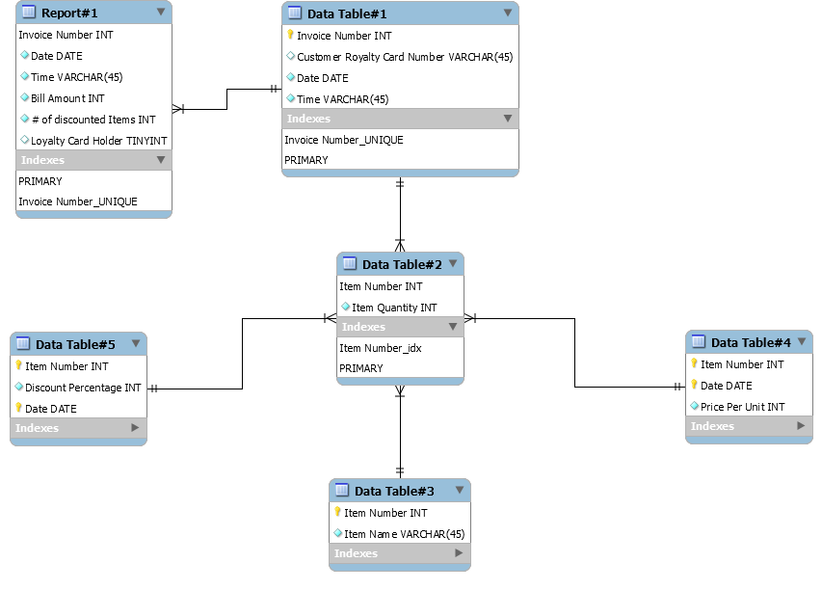
Part:1
Part:2
Report#1 Marketing Team Report
Invoice Number attribute is Primary Key for Data Table#1
Date, Time, Invoice Number, Customer Loyalty Card Number will be displayed in Report#1 using Data Table#1.
Item Number attribute is the Primary Key for Data Table#2
Quantity (to calculate Bill Amount) and Item Number (to fetch Item Price from Table#4 for Bill Amount) are extracted from Data Table#2.
Item Number attribute is the Primary Key for Data Table#3
Price Per Unit will be used from Data Table#4 (for Bill Amount calculation)
Discount Percentage is extracted from Data Table#5 for Bill Amount calculation.
In Report#1 Marketing Team Report, Invoice Number attribute will be Primary Key as it will uniquely identifies the records
Database Schema
Report#1 Marketing Team Report

Slide 5
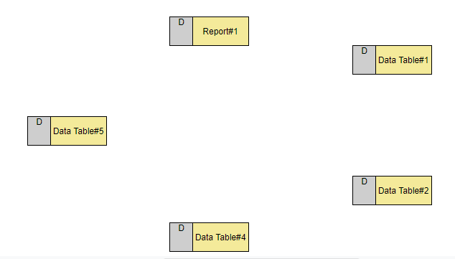
Part:1
Part:2
Dataflow Diagram for Report#1 Marketing Team Report
Date, Time, Invoice Number, Customer Loyalty
Discount
Date
Date
Invoice Number
Bill Amount
Item Number, Item Quantity
Item Number, Item Quantity

Slide 6
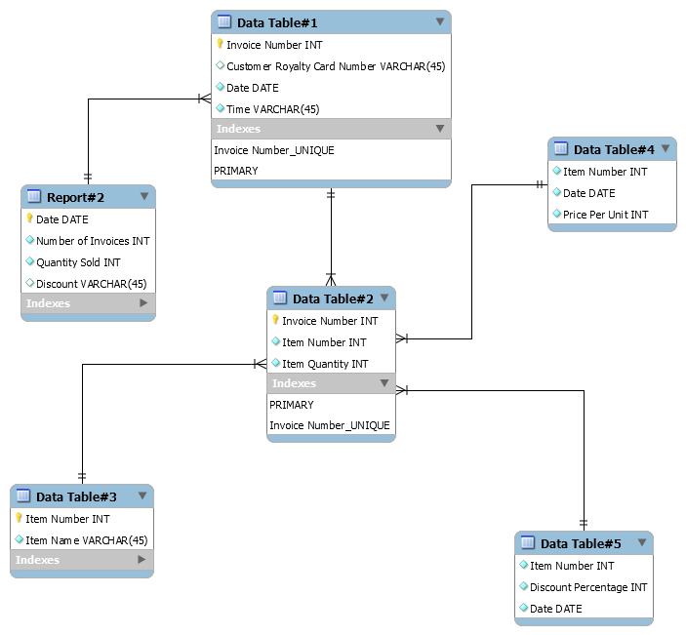
Part:1
Part:2
Report #2 Sales Inventory Report
Database Schema
Invoice Number attribute will be the Primary Key for Data Table#1.
Date and Number of Invoices will be displayed in the Report#2 using the Data Table#1
Invoice Number attribute will be the Primary Key for Data Table#2.
Using the Data Table#2, for each Invoice Number, the Item Quantity will be fetched to display it in the Report#2
Item Number attribute will be the Primary Key for Data Table#3.
Discount will be displayed in the Report#2 using Discount Percentage from Data Table# 5
Date Attribute will be the Primary Key for Report#2 Table as each entry will be uniquely identified based on the Date of transactions.
Report#2 Sales Inventory Report

Slide 7
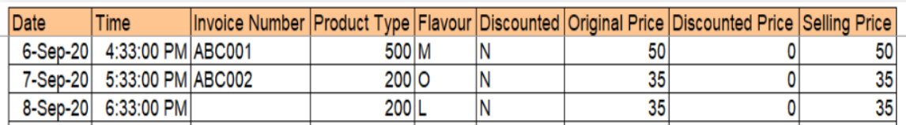
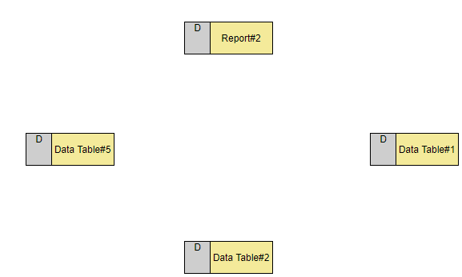
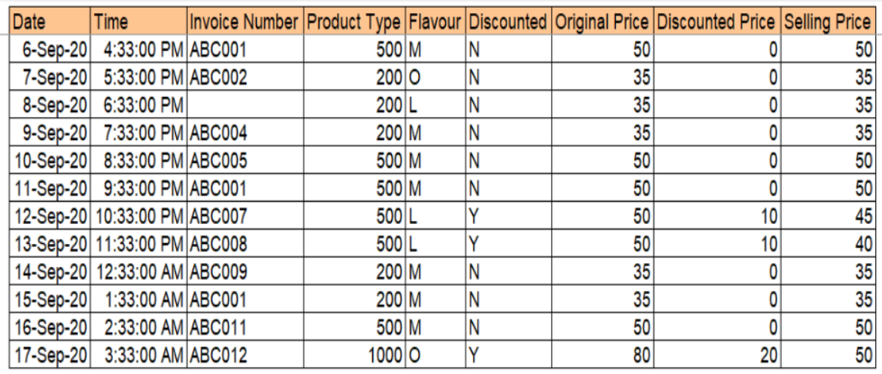
Part:1
Part:2
Dataflow Diagram for Report#2 Sales Inventory Report
Part-2, Question1
Data Integrity:
Null Values
Discount
Date, Number of Items
Quantity
Repetition of data Invoice Number ABC001
Date
Invoice Number
Data Validation:
Item Number
Here, Selling Price is not equal to Original Price - Discounted Price
Data Consistency: We can see our database is not normalized and hence this could lead to anomalies in the database. We can include another table like Product Id table to reduce Data Inconsistency (explained in next slide)

Slide 8
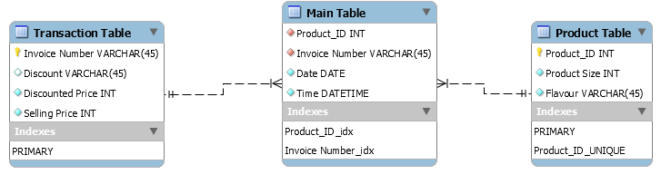
Part:1
Part:2
Question:2
Question:3
Suggested Database Schema
Additional data for better Analytics
Age Data: Age data would help us to analyze which age group purchases Aqua’s Products most frequently and help us to streamline marketing strategy accordingly.
Geographical Data: Geographical data would be instrumental for computing the locations where Aqua’s products tends to have greater sales.
Demographic Profile Data: Demographic profile includes gender, marital status, religion etc. This data would help to analyze Aqua’s consumer base more properly and this would be beneficial for designing marketing campaign.
Behavioral Data: This dataset includes factor like intensity of product use, Brand Loyalty, User behavior, this data would help us to analyze customer behavior.
All the above data will enormously help us to understand customer behavior and market dynamics and if we incorporate these into our strategies it will greatly increase Aqua’s revenue.
To avoid anomalies in the database it is advisable to have normalized form of Database, denormalized database can have anomalies like Update Anomalies , Deletion Anomalies, Insert Anomalies.
We have made a new additional attributes: Product_ID for building relations between tables.
Product_ID : This is a attribute which uniquely identified each flavor and size of Juice. This attribute acts as foreign key in Main Table and It is primary key in Product Table.
.

Slide 9
THANK YOU
Submitted By:
Shivank Rastogi
Abhishek Chand
Areeb Bashir Lone
Mohd. Asjad Kamal

